Slide 1




Loop Me In! Introducing Microsoft Loop: A Revolutionary Collaboration Tool
Lance D. Lingerfelt M365 Specialist LDLNET LLC

Slide 2


Agenda
Overview What is Microsoft Loop? Key features and benefits How it enhances collaboration
The Power of Microsoft Loop Real-time collaboration across teams and departments Seamless integration with Microsoft 365 apps (Word, Outlook, Teams, etc.) Centralized workspace for files, tasks, and conversations
Getting Started with Microsoft Loop Signing up and setting up Loop Navigating the user interface Inviting team members to join
Collaboration Features Shared workspaces for projects and tasks Integrating Loop with Microsoft Teams and other apps
Use Cases Project management and tracking progress Brainstorming and ideation sessions Team meetings and virtual collaborations
Security and Privacy Microsoft's commitment to data security Encrypted communication and file storage Compliance and data governance
Future Developments Upcoming features and updates Microsoft’ 365 Roadmap
Conclusion Recap of Microsoft Loop's benefits
Q&A Open the floor for questions and answers

Slide 3
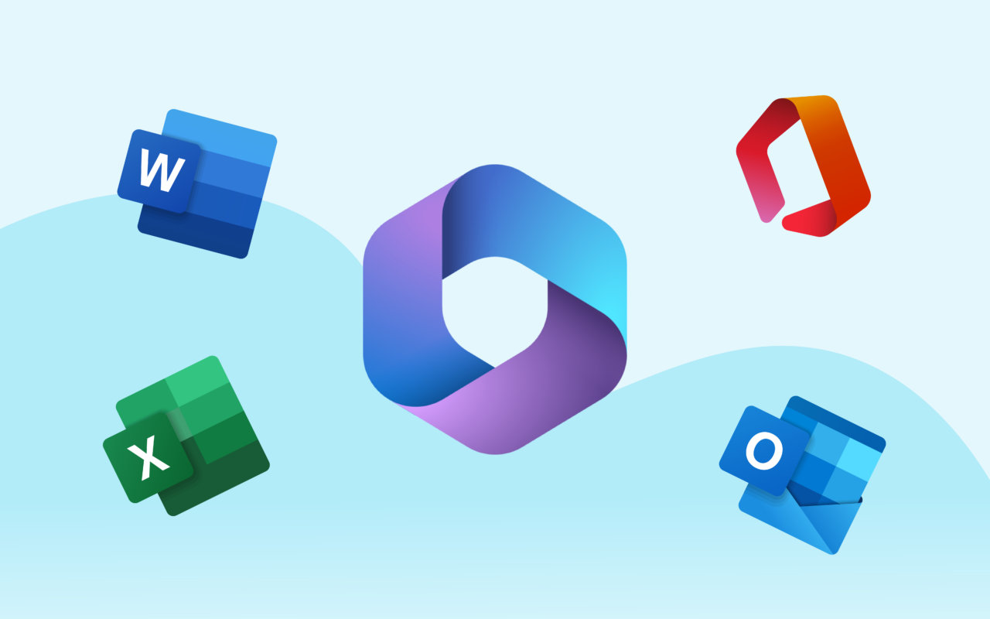

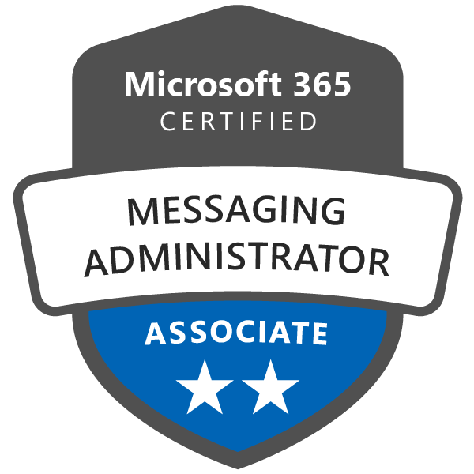
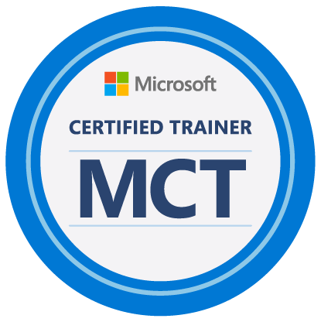
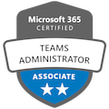

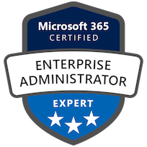
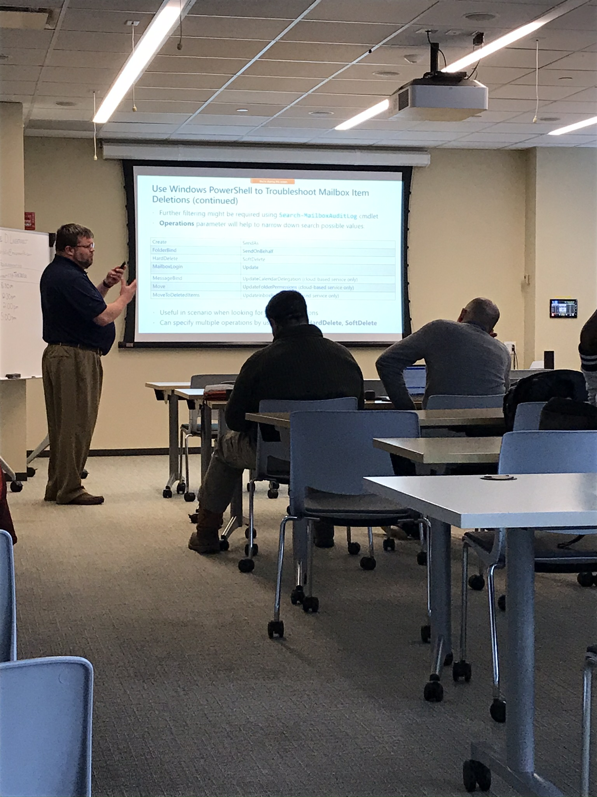





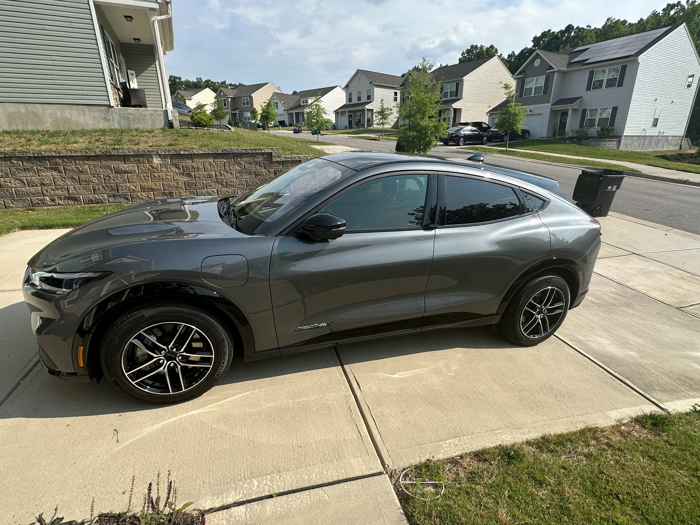


Lance Lingerfelt
Over 20+ years IT and MCT experience. M365, MCSE Certified
Worked for Microsoft and currently own my own company LDLNET LLC
Exchange/ AD / Entra / Teams SME, Security Architect, and Migration Specialist
Extensive PowerShell Scripting Experience
M365 Community Evangelist, Saxophonist, Company Owner, and Vehicle Enthusiast
https://itblog.ldlnet.net
https://www.linkedin.com/in/lance-lingerfelt-a27bb035

Slide 4
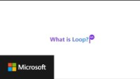


Overview
What is Loop? See the Video!
Benefits of Loop! Key Features!
How it enhances collaboration!

Slide 5

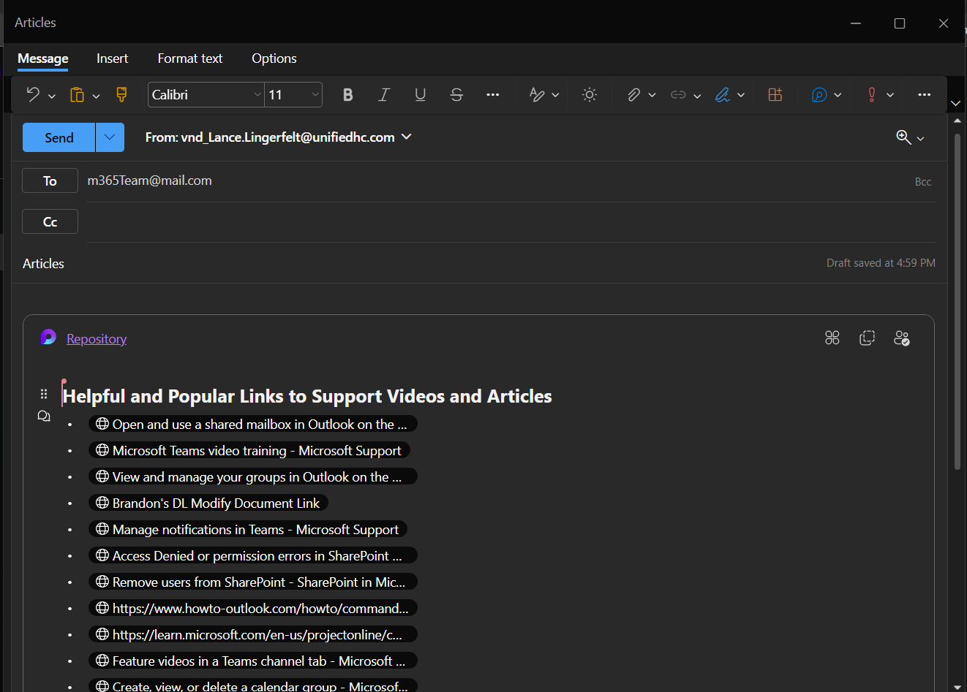
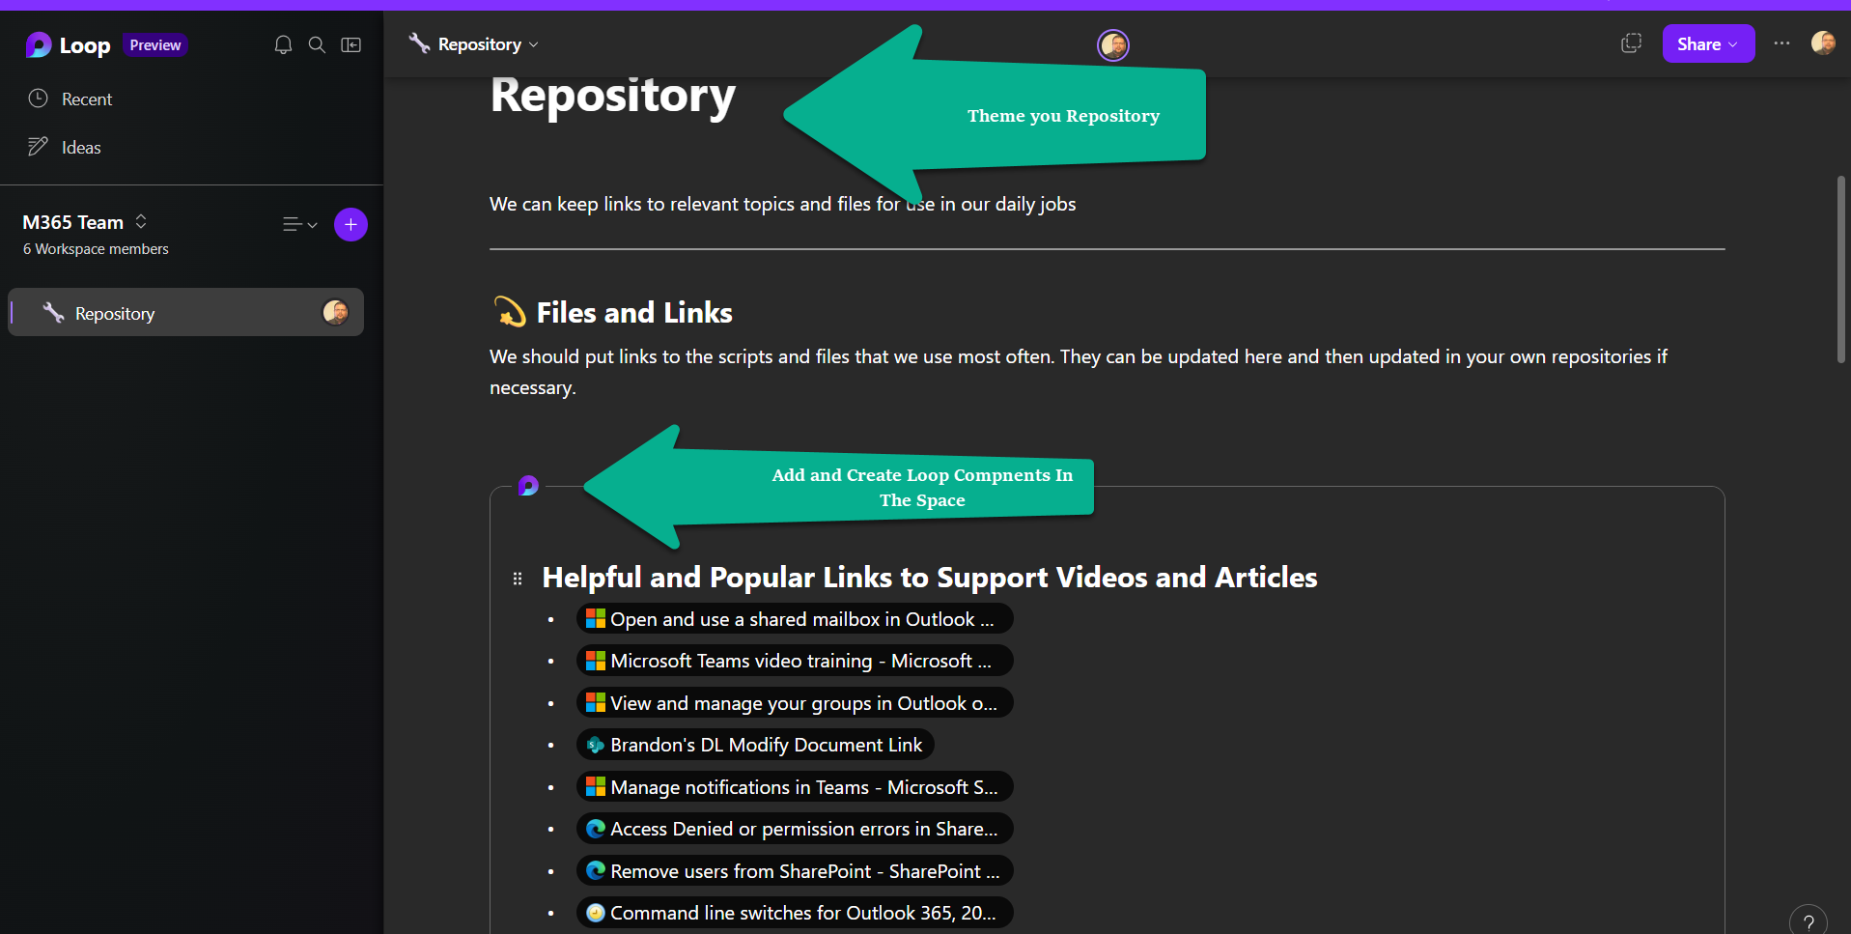
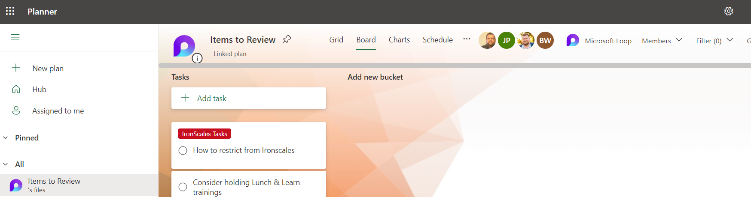
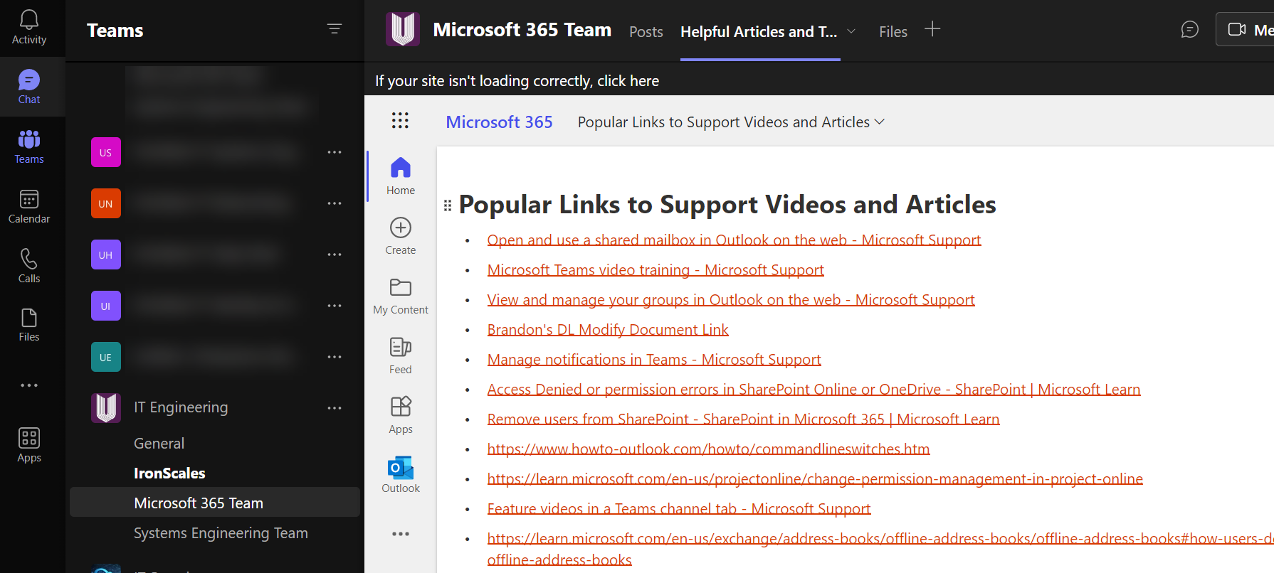
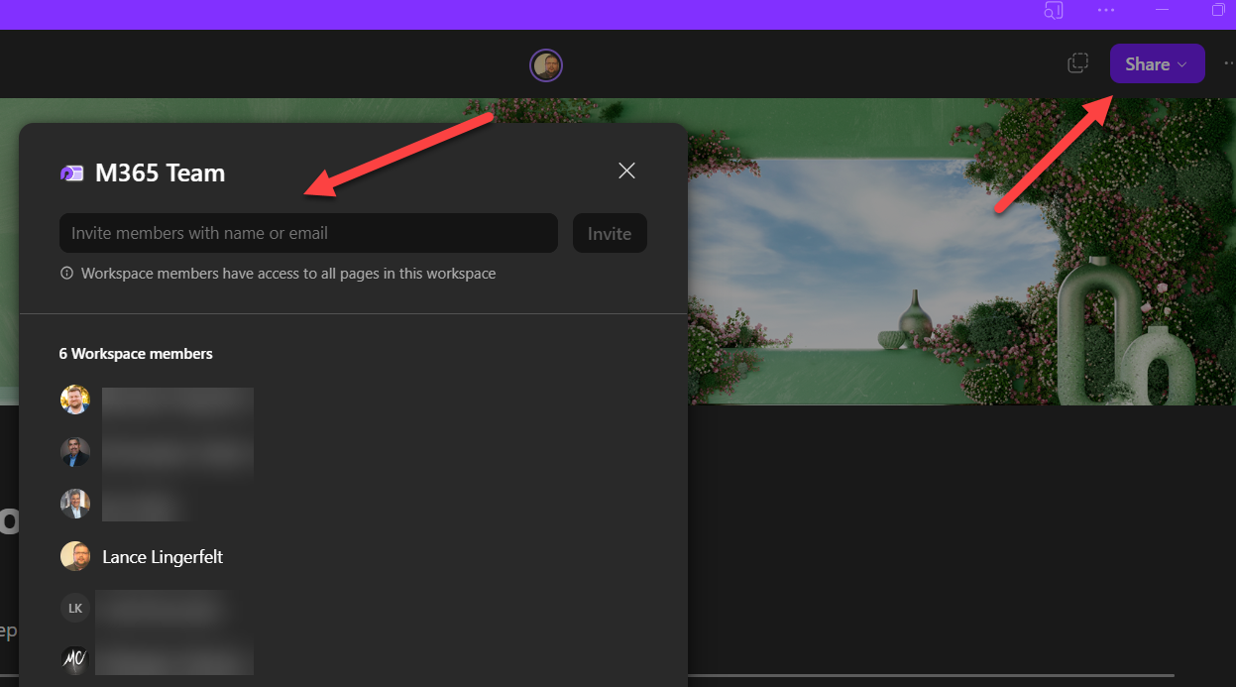
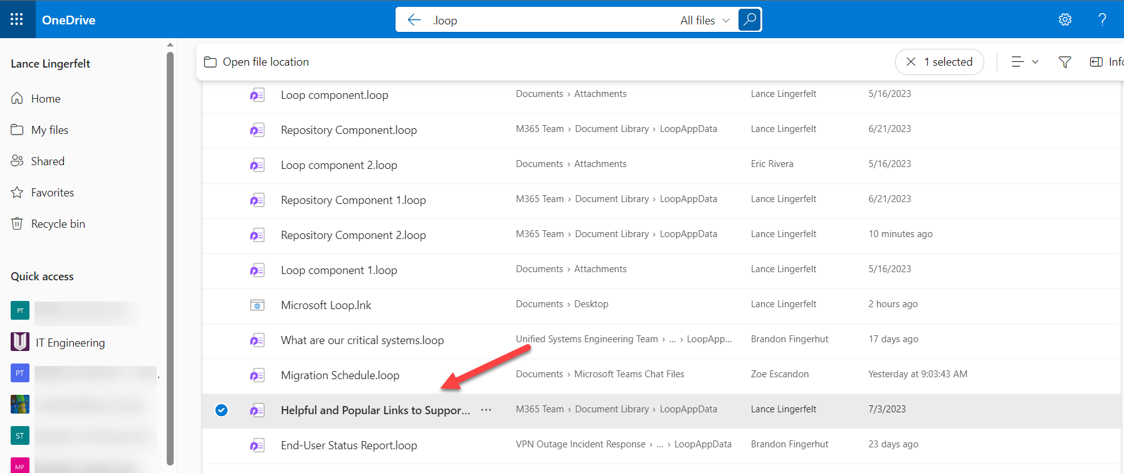
The Power of Microsoft Loop
Real-time collaboration across teams and departments Seamless integration with Microsoft 365 apps (Word, Outlook, Teams, etc.) Centralized workspace for files, tasks, and conversations

Slide 6
Get Started with MS Loop
Signing up and setting up Loop Navigating the user interface Inviting team members to join

Slide 7

Setting up Loop in your Org
Create a new Microsoft 365 group that contains all the users in your organization who you want to grant access to the Loop app during Public Preview.
Sign into the Microsoft 365 Apps admin center and create a Cloud Policy configuration, scoped to the Microsoft 365 group mentioned above, or to the full tenant, to enable the Loop app.
Wait an hour or so for the policy to propagate and log in to Loop!
Notes:
Learn how to enable the Microsoft Loop app, now in Public Preview - Microsoft Community Hub

Slide 8
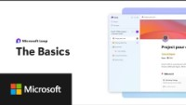
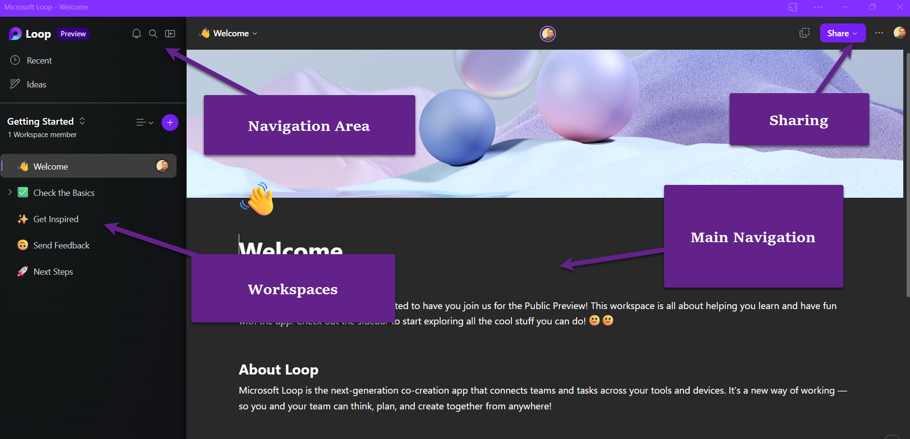
Getting Started with Loop
Navigate to Microsoft Loop: Collaborative App | Microsoft 365 to access and download the Loop Application
Notes:
www.youtube.com – Loop Basics Video

Slide 9
Invite your Team to Join
Click the Share Button In Your Workspace
Choose Team Members To Share With

Slide 10
Collaboration Features
Shared workspaces for projects and tasks Integrating Loop with Microsoft Teams and other apps

Slide 11
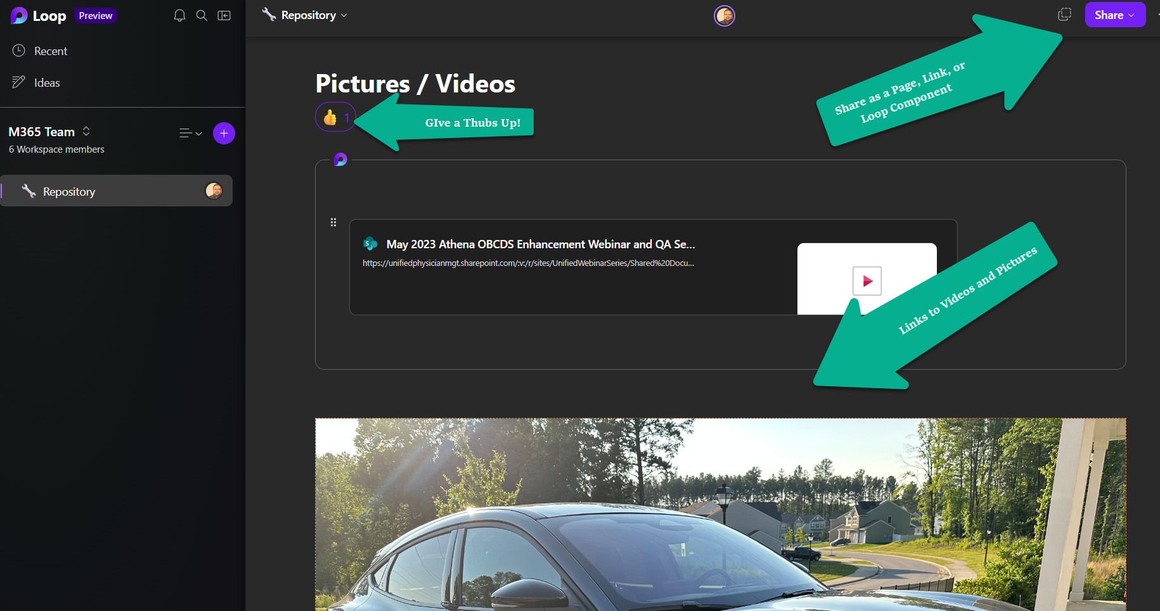
Shared Collaboration Workspaces
Share different content in one Collaborative Workspace where everyone can update in real time!
Notes:
www.youtube.com – Loop Basics Video

Slide 12
Loop Components and M365 Apps
Loop Components are Live Tile components that can be updated real time in all shared spaces
Used in Teams, Outlook, Word, Planner, OneNote, and more to come!
Share Lists, Outlines, Tasks, Q/A, and other data to be worked within the component
Saved as .loop files in OneDrive
Notes:
www.youtube.com – Loop Basics Video

Slide 13

Use Cases
Project management and tracking progress
Brainstorming and ideation sessions
Team meetings and virtual collaborations
Notes:
Project Management – Create a Loop component with Tasks Linked to Planner that can be updated to the Project Manager in real time via Outlook, Loop, or Teams Chat Brainstorming – Use Workspace to collaborate ideas for a project and keep track of them in a Loop component. Can then be shared with Management for Implementation.
Team Meetings – Meeting notes can be supplied with a Loop Component in an Outlook E-mail or Word Document and keep for all repeating meetings in the one component rather than resending meeting notes every week. One component can be reviewed. Can be shared in multiple places.
Examples: Adaptive Card-based Loop components: Collaborate on live content in Teams and Outlook - Microsoft Community Hub
Example Video: Accenture captures information quickly and easily using Microsoft Loop - YouTube

Slide 14
Security And Privacy
Microsoft's commitment to data security Encrypted communication and file storage Compliance and data governance

Slide 15
Microsoft’s Commitment
SECURITY & Privacy
Unified Labeling & Data Loss Prevention
Review Microsoft’s Privacy Policy: Microsoft Privacy Statement – Microsoft privacy
How Loop components are stored securly in M365: Overview of Loop workspaces storage and permissions | Microsoft Learn
Loop Compliance Policy Settings: https://learn.microsoft.com/en-us/microsoft-365/loop/loop-components-configuration?view=o365-worldwide#available-policy-settings
Sensitivity labels enable users to assign a level of security for their Loop components to help ensure that sensitive information isn’t mishandled.
Administrators can create specific labels for their organizations to enable their users to choose an appropriate label for their components, which can encrypt the component as well.
DLP enables administrators to set content and keywords that are automatically flagged across an organization’s Loop components.

Slide 16
Future Developments
Upcoming features and updates M365 Roadmap for Loop: Microsoft 365 Roadmap | Microsoft 365
Notes:
Click Link and go over some of the upcoming features

Slide 17

Conclusion
Microsoft Loop is a relatively new app in Microsoft 365 that offers interactive components. The loop components allow you to work together on (task)lists, tables, or notes in a chat, email, or documents.
With all the tools, documents, files, and links that your team uses, it’s easy to feel overwhelmed. Microsoft Loop helps you organize everything you need for your project into a single workspace and even does the searching for you to kick it off.
Microsoft Loop is here to help with features like progress trackers and custom labels that help keep your team aligned on dynamic workstreams. Tasks you assign in the Loop app and in the task list component sync across Microsoft Planner and To Do so you always have the latest list of what you need to focus on. Comments, nudges, reactions, and emojis help you express yourself as you work with your team.

Slide 18
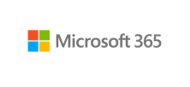
Questions???
Try Microsoft Loop!
Microsoft Loop: Collaborative App | Microsoft 365

Slide 19
Thank You!!!
Lance Lingerfelt
Lance.Lingerfelt@ldlnet.net
https://store.ldlnet.net

